Slide 1
Problem Statement Title: Automatic QR Drug Dispenser
Team Name: System Zombies
Team Leader Name: Mokshitha S
Institute Name: Sri Venkateswara College Of Engineering

Slide 2

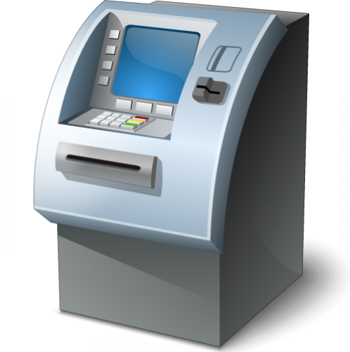
Problem statement :How can hospitals effectively address the issue of long queues that cause physical and mental inconvenience to patients, especially during the medication dispensing process, despite improvements in appointment scheduling for doctor consultations? Is there a solution that can streamline the medication collection process and enhance patient experience, such as implementing a QR Code drug ATM system capable of dispensing a wide range of Ayush Medicines available on-site?.

Slide 3
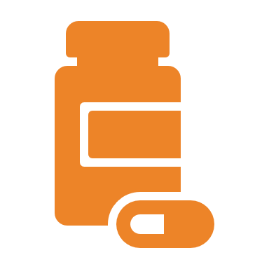
Proposed Solution: The proposed solution is to develop a QR Code drug ATM system that can dispense a wide range of Ayush Medicines available in a hospital or pharmacy. Patients will receive a QR code as part of their prescription. They can then visit the drug ATM, scan the QR code, and receive the prescribed medication. The system will ensure accuracy, efficiency, and convenience in the medicine dispensing process.
Key Features: Real-time Inventory Management, ML Enhanced Dispensing, Mobile App Integration, QR Code Encryption

Slide 4
Technology Stack:
Programming Languages : Python, Java, Javascript,Html,CSS
Hardware: Dispensing machine, QR code scanner/Webcam, Raspberry pi,servo motors
Software: Database management system, QR code generation and scanning libraries
Communicatio n: Wi-Fi or Ethernet for connecting the system to a central database
Security: Encryption and authentication protocols to protect patient data

Slide 5
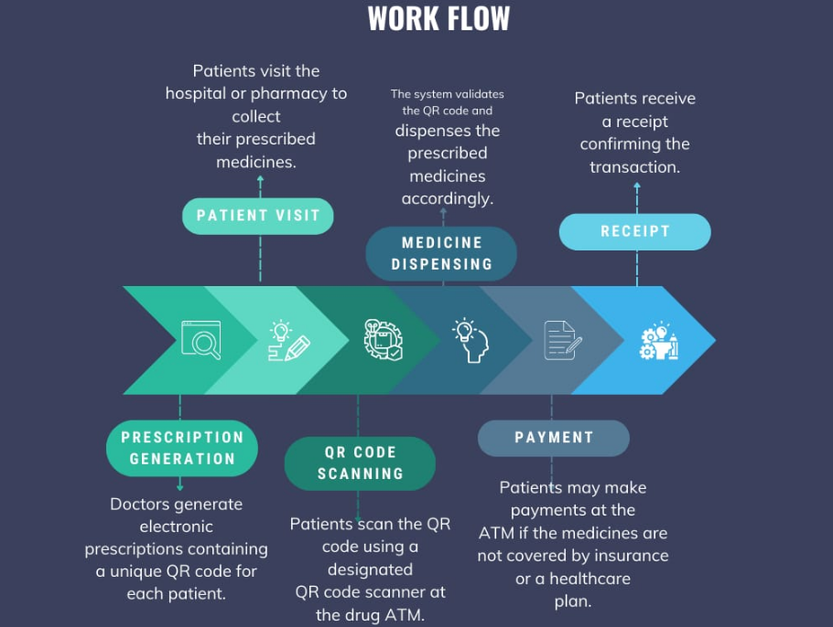

Slide 6
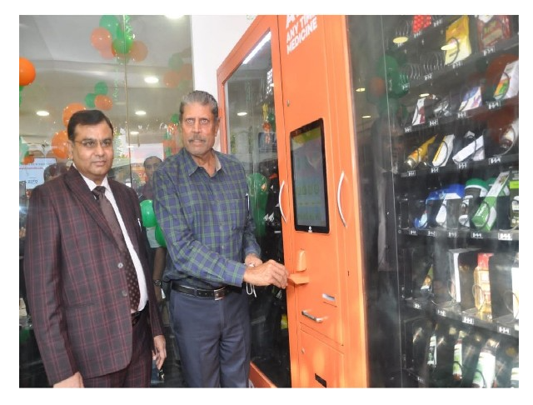
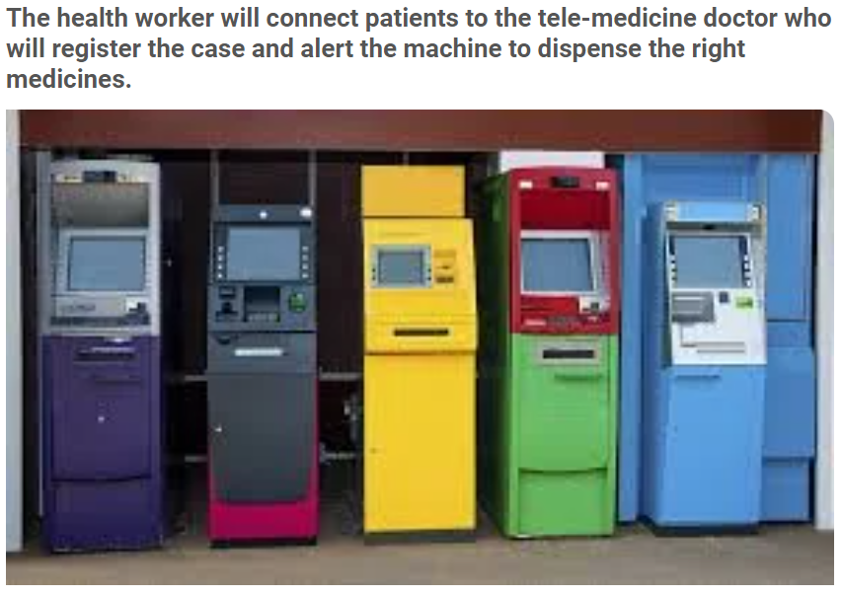
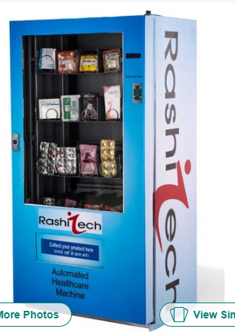
EXISTING SYSTEMS/MODELS
CHENNAI: A self-service kiosk that dispenses drugs like an ATM machine will be placed in 32 places, including 23 government medical college hospitals and urban primary health centres in cities such as Chennai, chief minister Edappadi K Palanisamy at the cost of 80 lakhs.

Slide 7
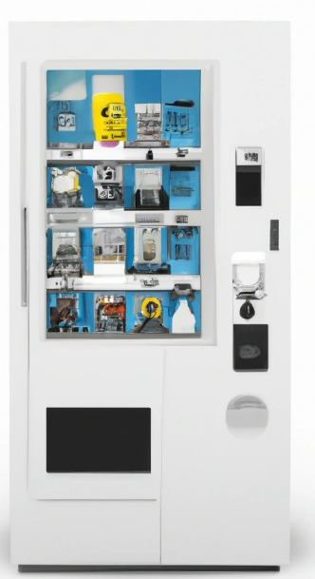
COST ESTIMATION
Hardware:
Dispensing Machine (Partial 3D Printing): -1, 00,000
QR Code Scanner: ₹5,000
Touchscreen Interface (Partial 3D Printing): ₹10,000
Secure Enclosure and Housing (3D Printing): ₹20,000
3D printing materials include PLA,ABS,Metal Powders, Nylon,PETG(their costs range from Rs 900-5000)

Slide 8
QR Code System:
QR Code Generation and Management: ₹5,000
Database and Backend Development: ₹10,000
Maintenance and Support:
Ongoing maintenance, updates, and support (per year): ₹20,000
Miscellaneous:
Installation and Setup: ₹10,000 - ₹30,000
Regulatory Compliance Costs (if applicable): Variable
Contingency (10% of total estimated cost): Variable
Total Estimated Cost (Low-End Estimate): ₹1,09,000 (approximately 1.09 lakhs INR)

Slide 9
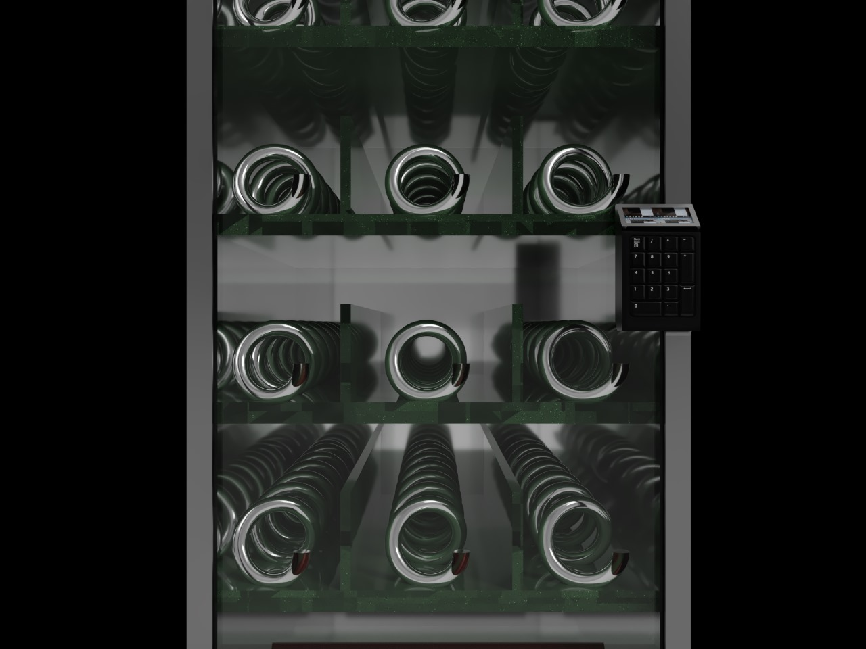
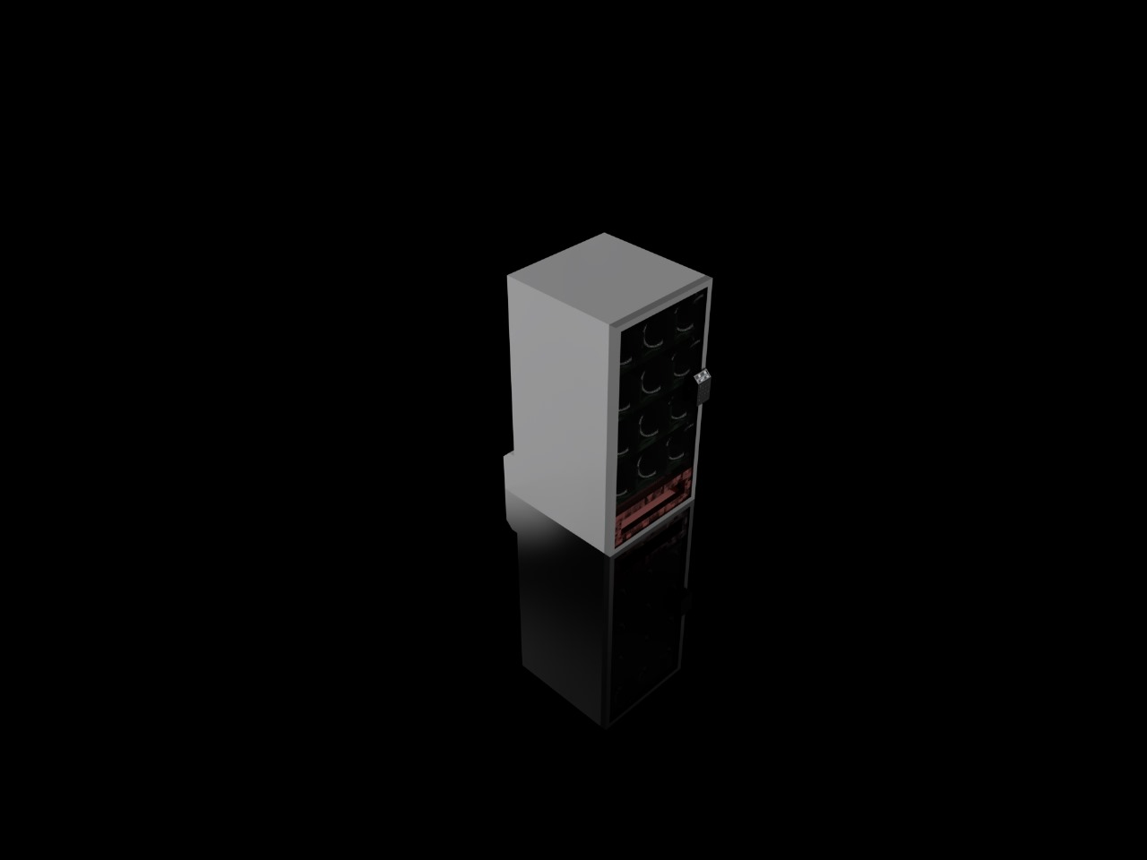
PROTOTYPE DESIGN

Slide 10
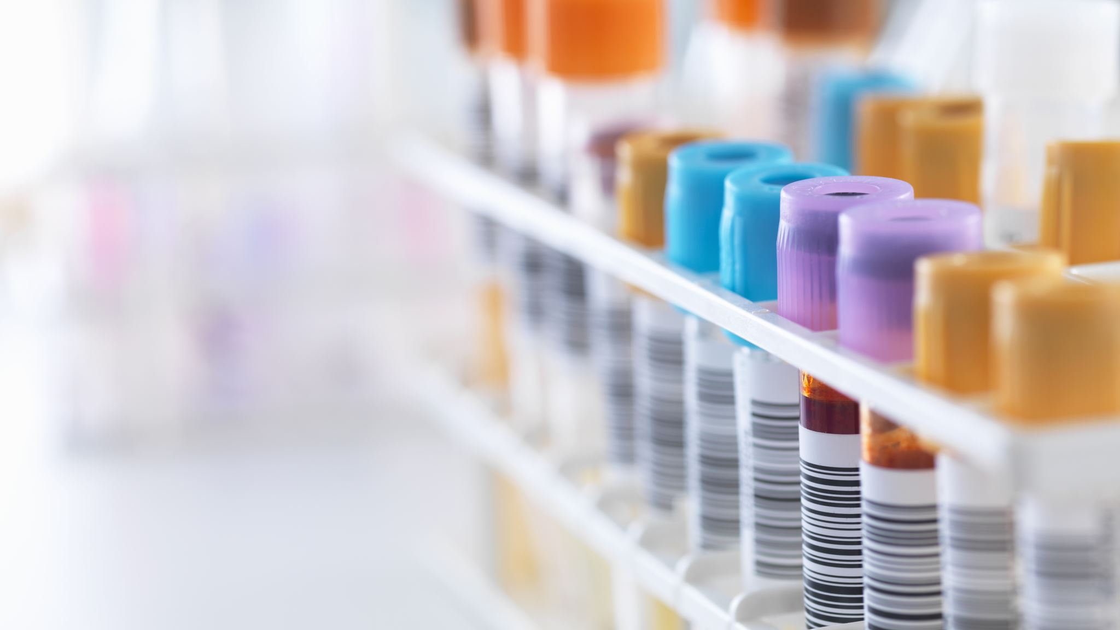
In Conclusion, this proposed QR Code drug ATM system has the potential to significantly improve the patient experience by reducing waiting times and streamlining the medicine dispensing process in hospitals and pharmacies.

